Slide 1
Project Proposal
Proteome Screen: RNA-binding proteins in non-synchronized HeLa cells
Topic 3, Group 1
Julian Baureis, Julia Ferdin, Benjamin Nicklas, Luisa Wintel
Supervisor: Maiwen Caudron-Herger

Slide 2
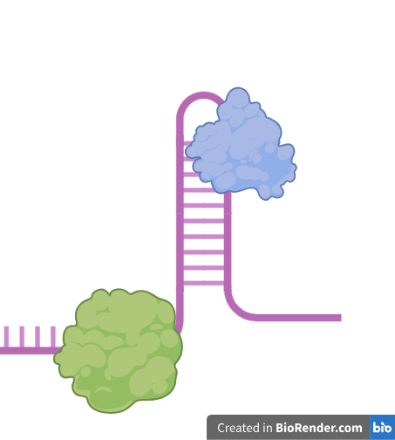
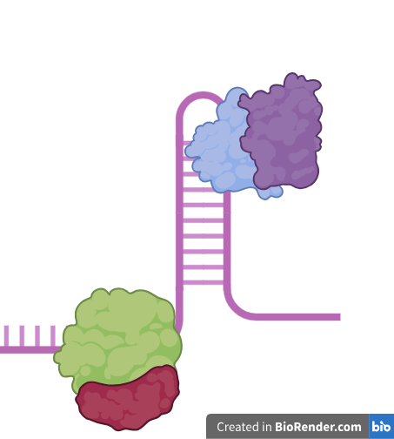
RNA-binding proteins non-synchronized HeLa cells

Slide 3
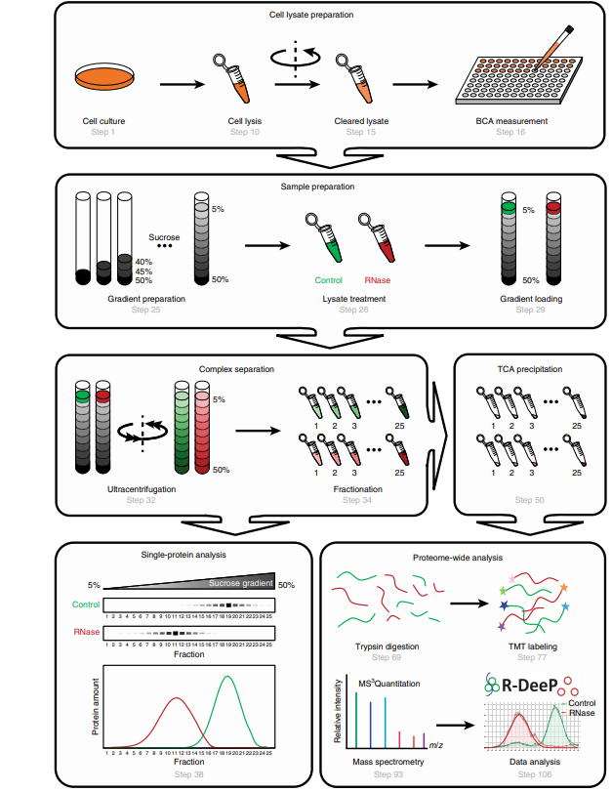
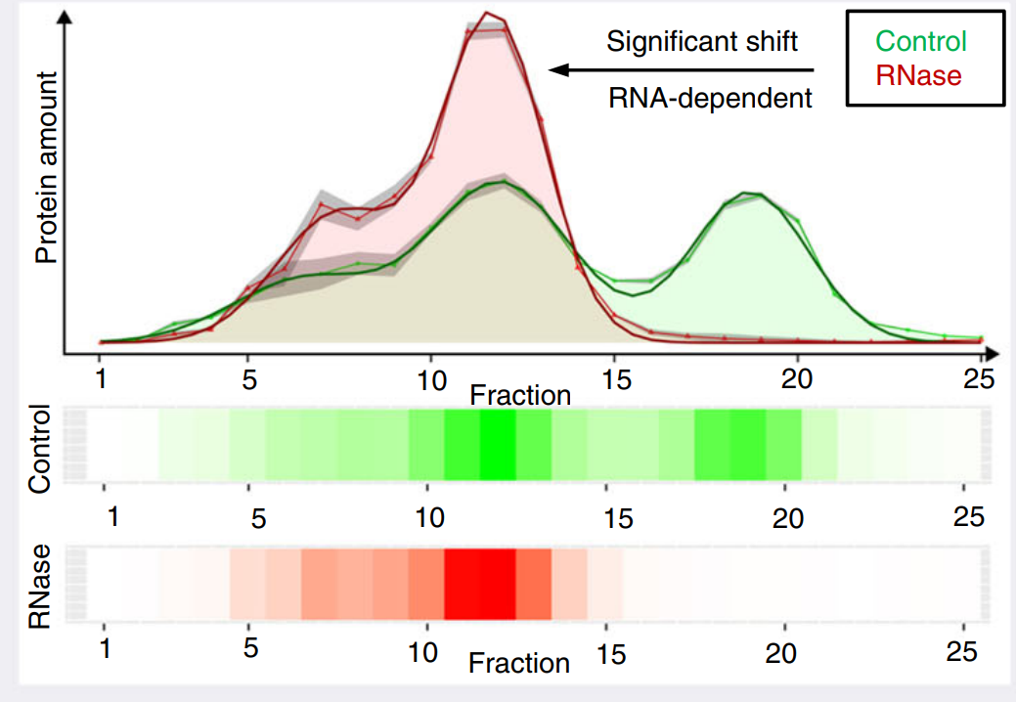
RNA dependence (R-DeeP)
Caudron-Herger et al., Identification, quantification and bioinformatic analysis of RNA-dependent proteins by RNase treatment and density gradient ultracentrifugation using R-DeeP, 2020, Nature Protocols

Slide 4
Which proteins in the non-synchronized HeLa cells are RNA-binding proteins?

Slide 5
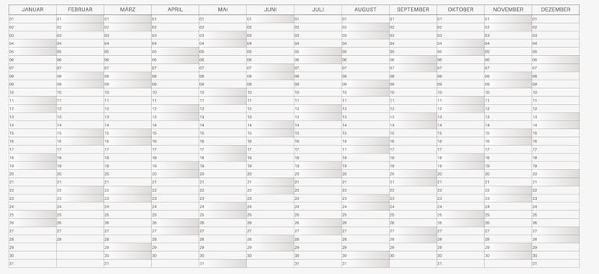
Time Table
https://www.google.com/url?sa=i&url=https%3A%2F%2Fwww.canva.com%2Fde_de%2Fkalender%2Fvorlagen%2F&psig=AOvVaw155hoQifX2EsWfPgBXsQLG&ust=1747057183090000&source=images&cd=vfe&opi=89978449&ved=0CBQQjRxqFwoTCIiCqKzFm40DFQAAAAAdAAAAABAE

Slide 6
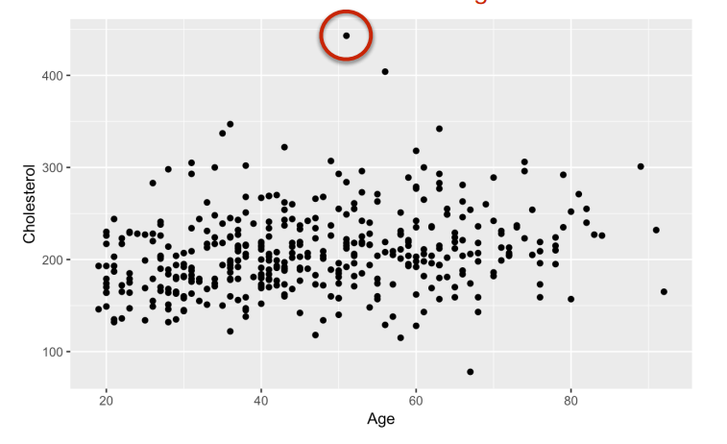
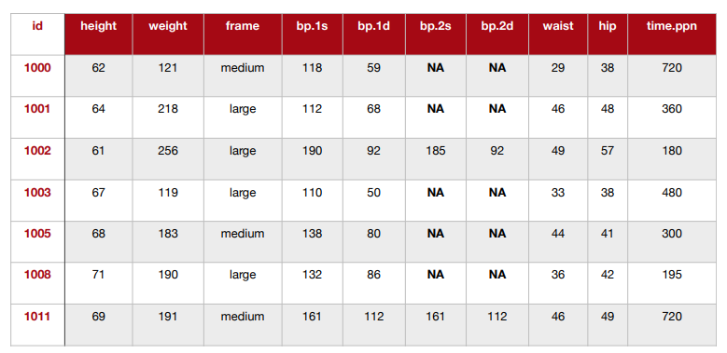
1. Week
19.05.-25.05.
Data cleanup
Removing low variance columns/rows
Removing batch effects
Removing technical outliers
Re-ordering data
Bioinfo-Slides aus dem 3. Semester

Slide 7
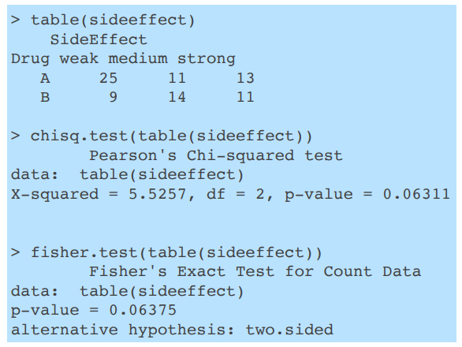
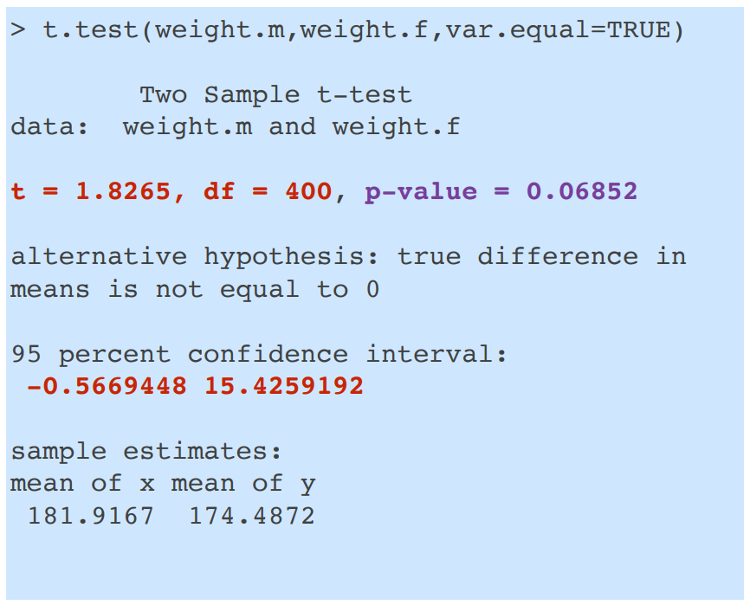
2. Week
26.05.-01.06.
Data exploration
data distribution
t-test
proportion test
Bioinfo-Slides aus dem 3. Semester

Slide 8
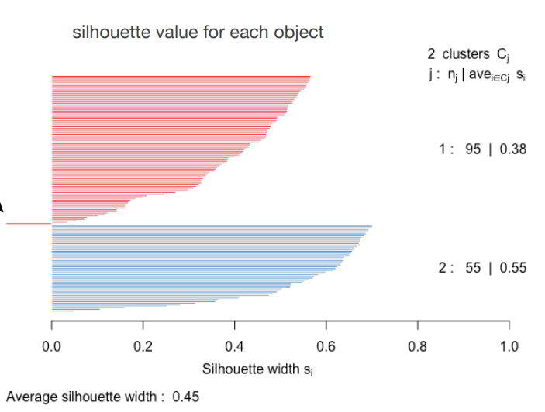
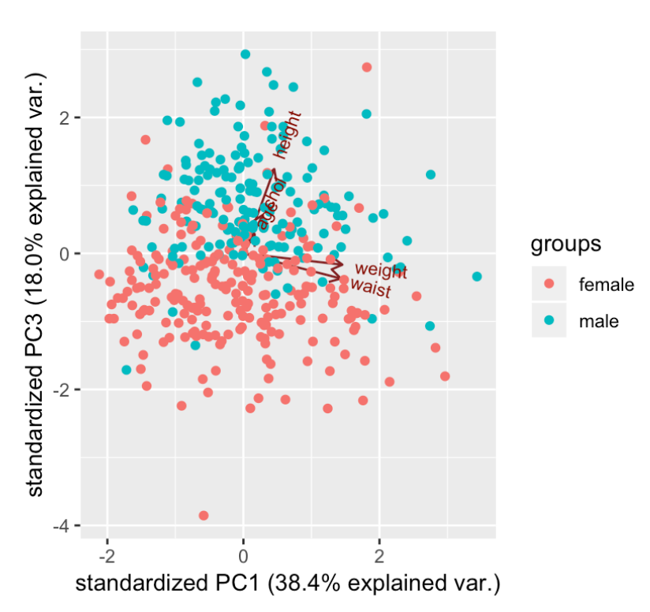
3./4. Week
02.06.-15.06.
Data reduction
PCR
k-means
linear regression analysis
Bioinfo-Slides aus dem 3. Semester

Slide 9
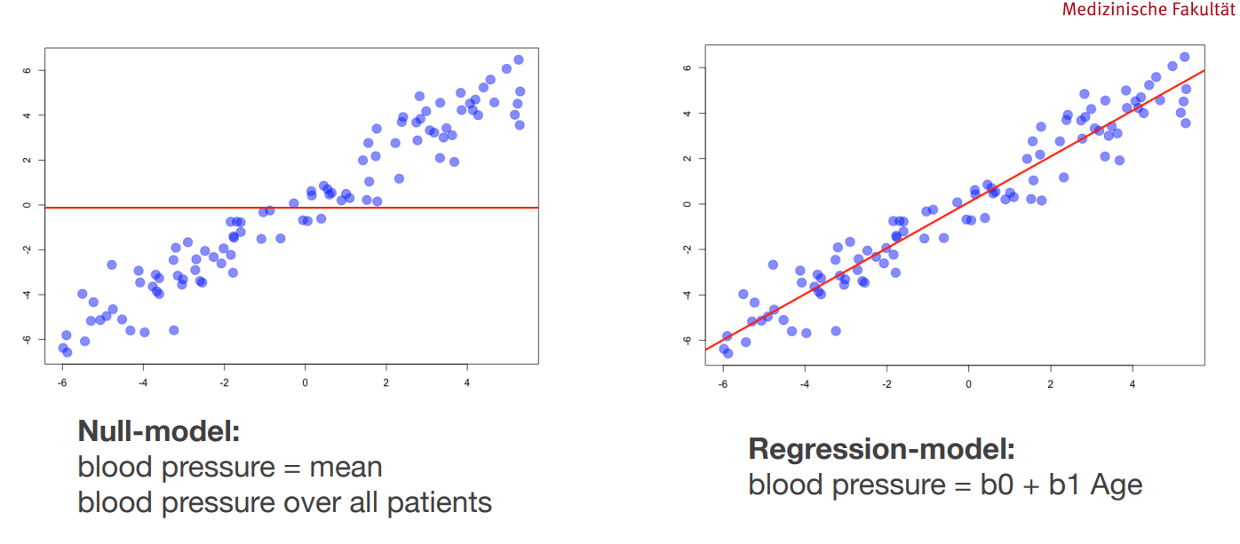
Bioinfo-Slides aus dem 3. Semester

Slide 10
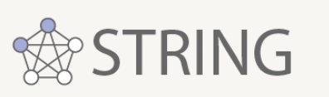

5.-7. Week
16.06.-06.07.
Data modelling
Data presentation
define selection criteria for RNA-dependent proteins
predict whether a protein is a RNA-dependent proteins
poster
final presentation

Slide 11
Thanks for listening

